Slide 1
ANZ Transaction data analysis
what is the average transaction amount?52.57
Average transactions do customers make each month? 111.6
The outlier in every state for both credit and debit is high.

Slide 2
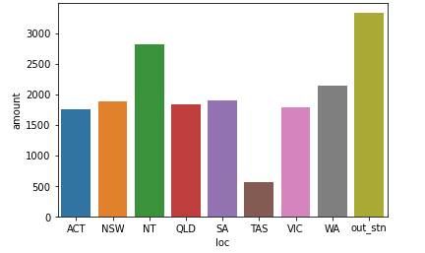
State wise income analysis
The analysis on income
of various state reveals
that
Average salary of
customers is about $2000
State NT has the highest
salary
State TAS has the lowest salary

Slide 3
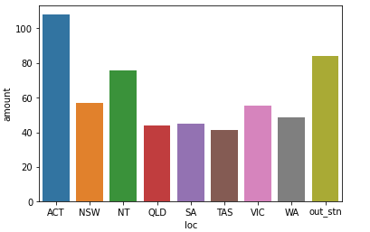
State wise spending analysis
The average spending in these states is about $63
The highest spending is
in the state ACT, about $100.
Minimum is in the state of TAS, about $40

Slide 4
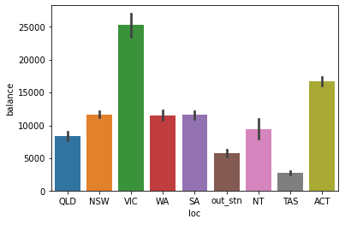
Saving habbit in the sates
The average saving in the states is about $12000
The state vlc saves the most with 25000
State tas saves the list with $2500

